Slide 1



Delivery Delay Analysis
Insights into Delivery Performance and Optimization
-Presented by Argha Nandi
Email : argha_2312res155@iitp.ac.in

Slide 2
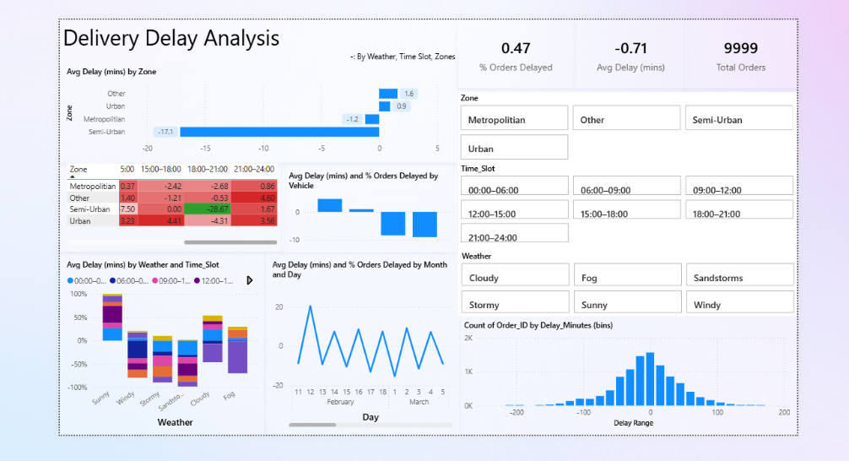
Overview of Report Objectives
The primary objective of this report is to analyze delivery delays within various zones. It examines the average delay experienced due to factors such as vehicle type, weather conditions, and time slots. By focusing on these elements, the report aims to identify trends and areas for improvement that can enhance delivery efficiency.

Slide 3
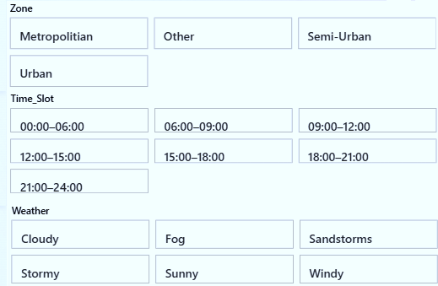

Key Data Sources and Metrics
This analysis utilizes data from order management systems, focusing on several key performance indicators (KPIs). Metrics include average delivery delay, percentage of orders delayed, and total orders processed. The incorporation of slicers for zones, time slots, and weather further enriches the analysis, allowing for detailed exploration of delivery performance across different conditions.

Slide 4
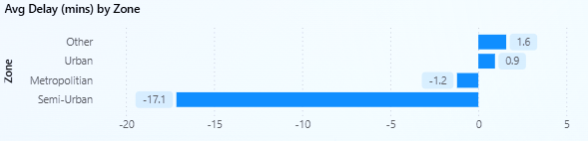
Average Delay by Zone
The bar chart illustrates the average delivery delay across different zones. It enables quick visual assessment and comparison of performance. By identifying zones with the highest average delays, organizations can focus their resources and strategies on these areas to improve service speed and reliability. Insights drawn from this visualization can lead to targeted interventions for enhanced operational effectiveness.

Slide 5
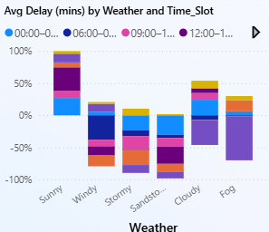
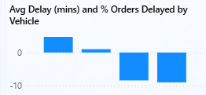
Delay Analysis by Vehicle and Weather and Time Slots
The clustered column charts present average delays categorized by vehicle types and weather conditions. This dual analysis allows for insights into how different factors impact delivery performance. Understanding which vehicles experience significant delays under specific weather scenarios helps in fleet management and planning. Making informed decisions based on this data can significantly enhance delivery reliability and minimize disruptions.

Slide 6
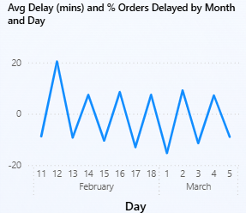
Monthly and Daily Delay Trends
The line chart tracks average delay minutes over months and days, highlighting trends and fluctuations within the delivery timeline. This visualization assists in identifying peak periods of delays, allowing for proactive measures to be taken. Recognizing these patterns can guide capacity planning, resource allocation, and operational adjustments to mitigate future delays effectively.

Slide 7
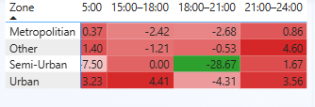
The heatmap “Avg Delay (mins) by Weather and Time Slot” in the dashboard is designed to show how different weather conditions interact with different time slots of the day to affect delivery delays. Instead of just looking at weather or time separately, it combines them to reveal patterns.
THE HEATMAP

Slide 8
Conclusions
The analysis of delivery delays reveals critical insights for operational improvement. Key contributing factors include zone-specific challenges, vehicle-related issues, and the influence of weather conditions. By leveraging the visualizations presented, stakeholders can devise focused strategies to reduce delays, optimize resource allocation, and enhance customer satisfaction in delivery services. Implementing these findings will lead to more efficient logistics operations and improved overall performance.
Thank you!

